Slide 1
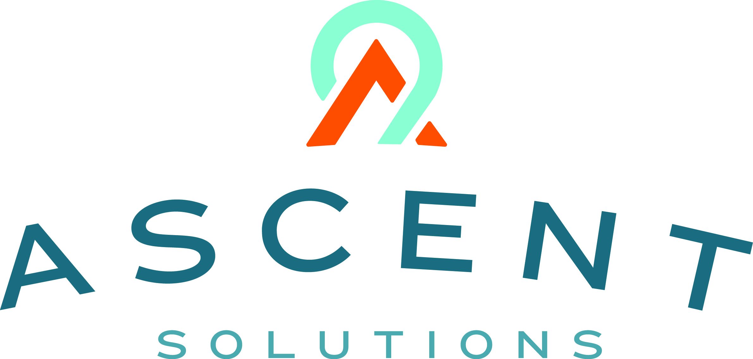

Content: aka.ms/omahadevdays
Survey: aka.ms/ncrdevdayssurvey
#Azuredevdays

Slide 2
Developer Services in Microsoft Azure
Frank Migacz

Slide 3







It’s a great time to be a developer!
Digital Life
Smart Devices
Smart Home
IoT
68
Intelligent Vehicle
Connected Factory
Smart City
Connected Retail

Slide 4
Cloud app continuum
SaaS apps
Serverless
Replace
Microservices
Rebuild New
Engineering Complexity and Cost
Containers
Rearchitect
VMs
Refactor
Existing on-premises applications
Rehost
App Modernization
Agility – Time to Market – Total Cost of Ownership – IT Simplification

Slide 5
The Microsoft IT journey to Azure
~30%
Retire it, right-size, eliminate environments
From
Office servers
Portals and SPS
Any CRM
From
Source control and WIT
Data warehouses
Industry verticals
To
Office 365
SharePoint Online
CRM Online
To
VSTS
ADL + Power BI
Best third-party SaaS
Use or convert to a SaaS (first or third-party) solution
~15%
Expose functionality in existing SaaS/PaaS solution
First to move
Basic web apps
Advanced portals
Any new solutions
Re-architected solutions
Next to move
High I/O OLTP
Regulatory and high business impact
Hard or costly to move
HVA systems
PKI systems
Legacy source control
Convert to Azure PaaS solution
~35%
~10%
~5%
Optimize for and move to Azure IaaS
No change, lift and shift to IaaS
Remain on-premises
<5%
Journey to Azure
> 3500 applications

Slide 6
Top 3 learnings
1
It’s a great opportunity to ‘clean house’ - retire applications that are no longer used or consolidate and transition functionality to off-the-shelf solutions where possible.
No cloud hosting model (IaaS, PaaS, SaaS) should be taken off the table too early.
Move custom applications in stages:
Move simple workloads directly to PaaS: web sites, static portals, standard three-tier applications.
Migrate complex solutions to IaaS first to unlock immediate benefits and gradually modernize later.
Keep legacy/undocumented code as-is and surround it with serverless functions to add features.
Download the eBook
https://azure.microsoft.com/resources/inside-microsoft-cloud-migration-journey/
2
3

Slide 7

https://azure.microsoft.com/resources/inside-microsoft-cloud-migration-journey/

Slide 8
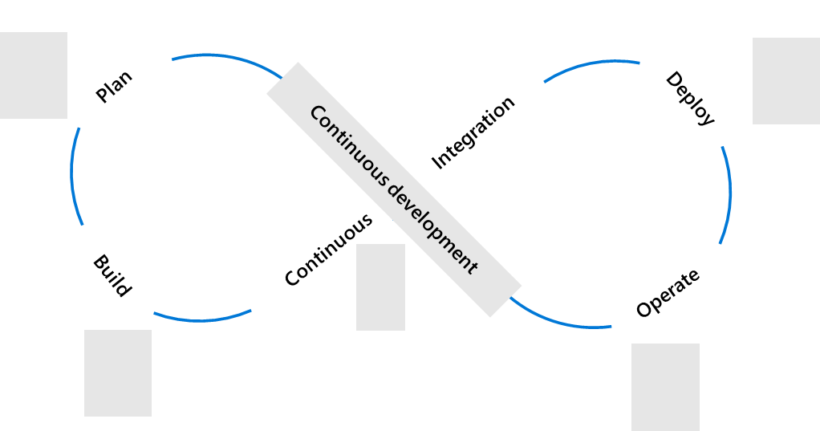
Deliver applications faster and more reliably
Plan + Track
Release
Development
Operations
Code, Build + Test
Operate + Monitor

Slide 9



Our journey to DevOps
PM, Dev, Test roles
Personal offices
Deep hierarchy
20+ team sizes
PM & engineering roles only
Team rooms
Flattened hierarchy
8-12 team sizes
People
4-6 month milestones
Features shipped once a year
Success is install numbers Long planning cycles
Secret roadmap
3-week Sprints
Features shipped every Sprint
User satisfaction determines success Continuous planning & learning
Publicly shared roadmap
Process
100 page spec documents
Proprietary SC, TFSVC
Feature branches
Proprietary toolchain
Mockups in PPT
Git
Everyone in master
Azure DevOps
Tools
Learn more: http://stories.visualstudio.com/devops/

Slide 10

http://stories.visualstudio.com/devops/

Slide 11
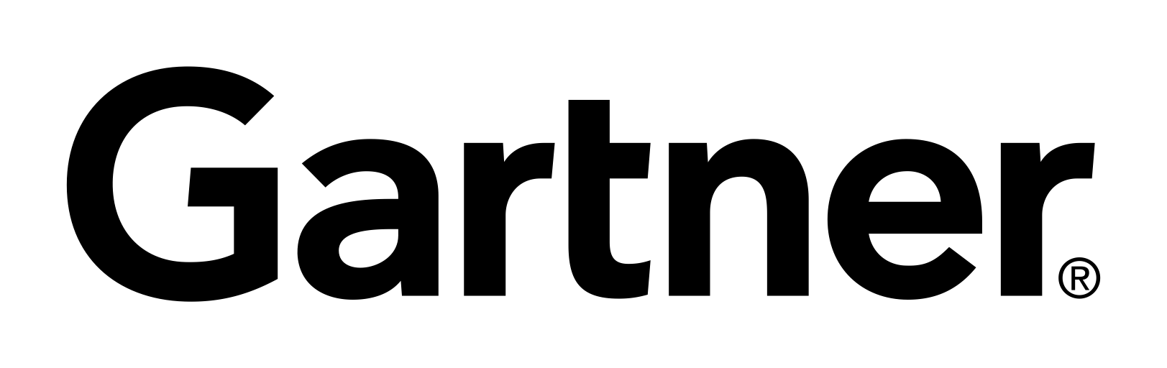

Containers momentum
“By 2020, more than 50% of enterprises will run mission-critical, containerized cloud-native applications in production.”
Half of container environment is orchestrated.¹
77%
77% of companies² who use container orchestrators choose Kubernetes.
The average size of a container deployment has grown 75% in one year. ¹
Larger companies are leading the adoption.¹
75%
50%
Nearly 50% of organizations¹ running 1000 or more hosts have adopted containers.
¹ Datadog report: 8 Surprising Facts About Real Docker Adoption
² CNCF survey: cloud-native-technologies-scaling-production-applications

Slide 12

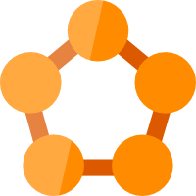

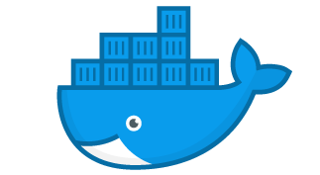




Containers in Azure
App Service
Service Fabric
Kubernetes Service
Container Instance
Ecosystem
Deploy web apps or APIs using containers in a PaaS environment
Modernize .NET applications to microservices using Windows Server containers
Scale and orchestrate Linux containers using Kubernetes
Elastically burst from your Azure Kubernetes Service (AKS) cluster
Bring your Partner solutions that run great on Azure
Azure Container Registry
Docker Hub
Choice of developer tools and clients

Slide 13
Cross-referencing workloads to value areas
Web & API apps
Data transformation
& reporting
Microservices
Rapid Application Development
Web Apps, IIS, ASP.NET [Core], Java, Python, Node.js, Angular, JavaScript, .NET/C#, WCF, Windows Service, SQL, Docker.
SQL, Excel, MS Access, ETL, SSIS/SSAS/SSRS, Informatica, SAS, Micro Strategy.
Loosely-coupled, independently deployable services.
Line of Business, Mendix, MS Access, Domino, IBM Notes, SQL, MS Excel, VBA, MS Word, Sharepoint.
Products
App Service Isolated (ASI)
Azure SQL
PowerBI
Applications Insights
Application Gateway
Products
Azure Data Factory
Azure Storage
Azure SQL [DW]
Data Lake Store & Analytics
Azure Analysis Services
PowerBI
Products
Azure Container Registry
App Service Isolated (ASI)
Applications Insights
Azure Container Instances
Azure Kubernetes Services
Service Fabric Mesh
API Management
Products
App Service Isolated (ASI)
Azure SQL
PowerBI
Applications Insights
Application Gateway
PowerApps
Flow

Slide 14
Top 3 learnings
1
Change mindset and behavior first:
Embrace a Growth mindset.
Have passion and evangelize (spread the word).
Governance is key:
Establish dedicated Cloud teams and skill up – cloud requires skills adjustments.
Invest in secure coding practices and code quality.
Adopt standard CI/CD pipelines – customization is great but can be tricky
Create measurable value:
Design and architect secure, compliant Azure products.
Leverage a Shared Service Model to implement DevOps.
2
3

